Slide 1

Real-Time Fluid Simulation (A+)
Simulate smoke by a more accurate advection solver
Implement the stable fluids solver
Modify the advection by the reflection solver
Implement them on GPU using CUDA
GPU-based volume renderer of velocity field
Reference
https://dl.acm.org/doi/pdf/10.1145/311535.311548
https://jzehnder.me/publications/advectionReflection/

Slide 2
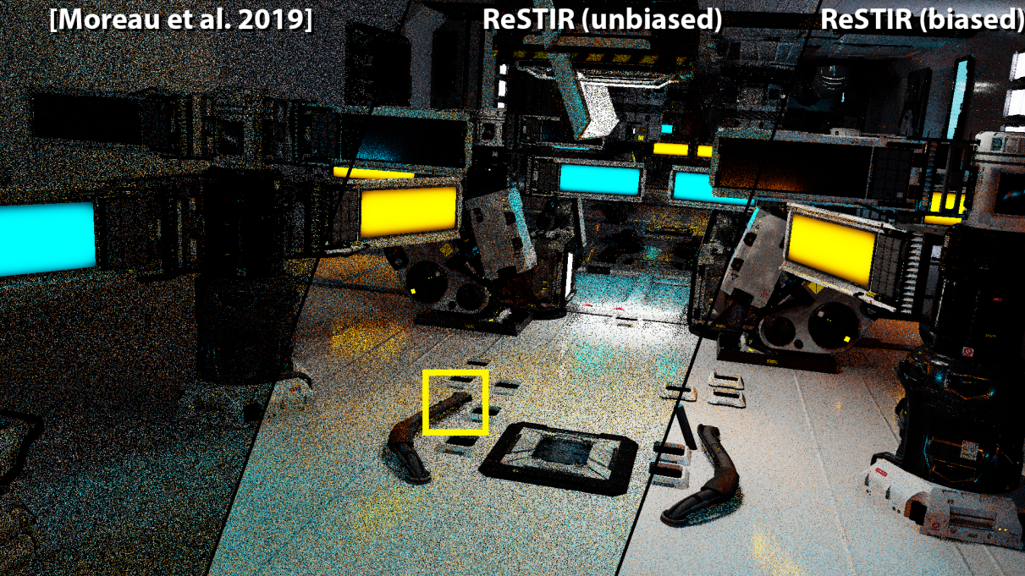
Reservoir Spatio-Temporal Importance Resampling (A)
Rendering surface with ReSTIR efficiently
Efficient sample many lights.
Reuse samples from other pixels.
Reference
[2020] Spatiotemporal reservoir resampling for real-time ray tracing
[2021] ReSTIR GI Path Resampling for Real-Time Path Tracing

Slide 3
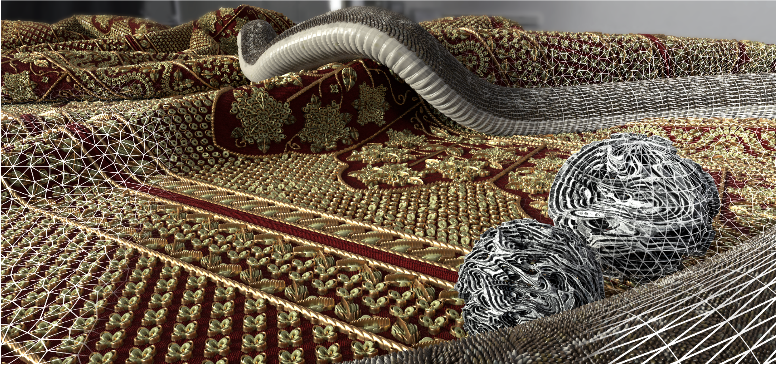
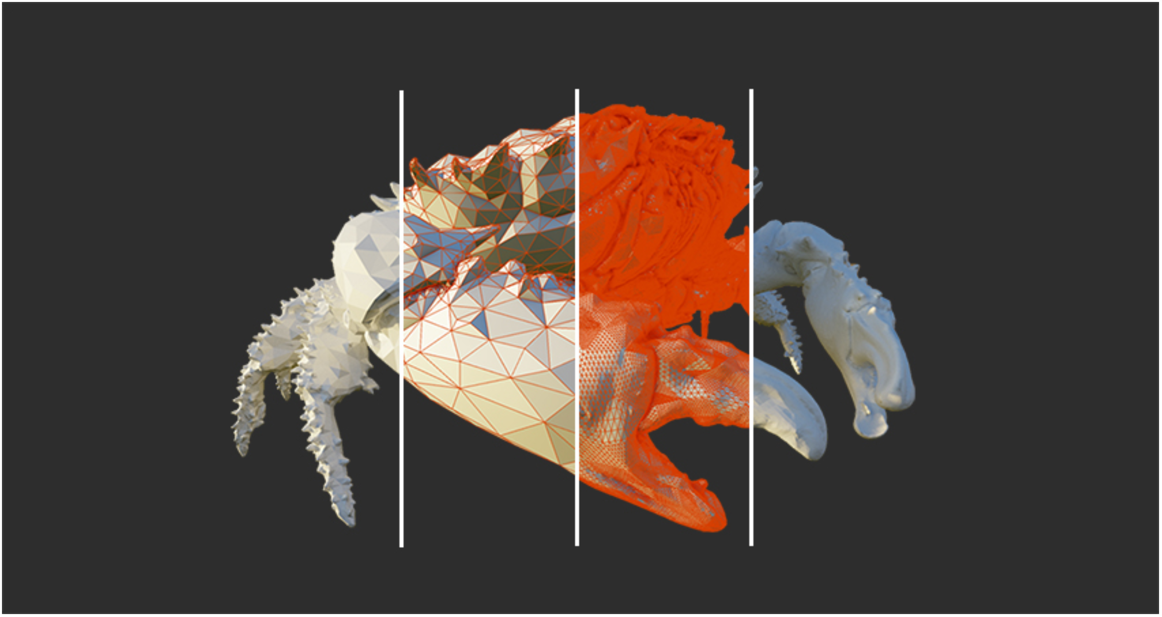
Render Intricate Geometries (A)
Displacement BVH
Implement building algorithms for displacement BVH
Implement traversal algorithms for displacement BVH
Reference
[2018] A High-Resolution Compression Scheme for Ray Tracing Subdivision Surfaces with Displacement
[2021] Tessellation-Free Displacement Mapping for Ray Tracing

Slide 4
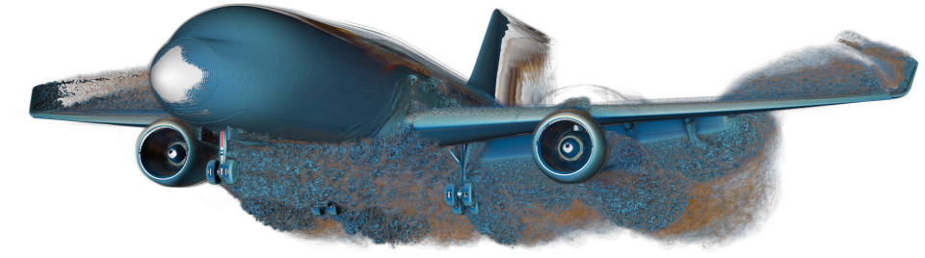
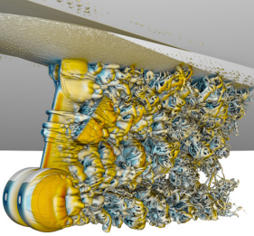
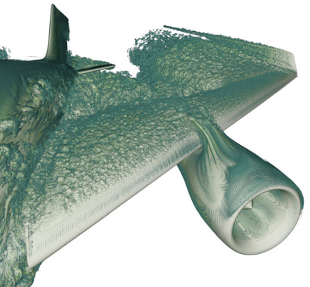
Multi-Resolution Isosurface Rendering (A)
Rendering isosurface with ray tracing based techniques
Build k‐d trees for isosurfaces encompassed in discrete volume data
Design transfer functions for isosurface rendering
Pre‐integrated transfer functioReference
Reference
[2021] Ray Tracing Structured AMR Data Using ExaBricks

Slide 5
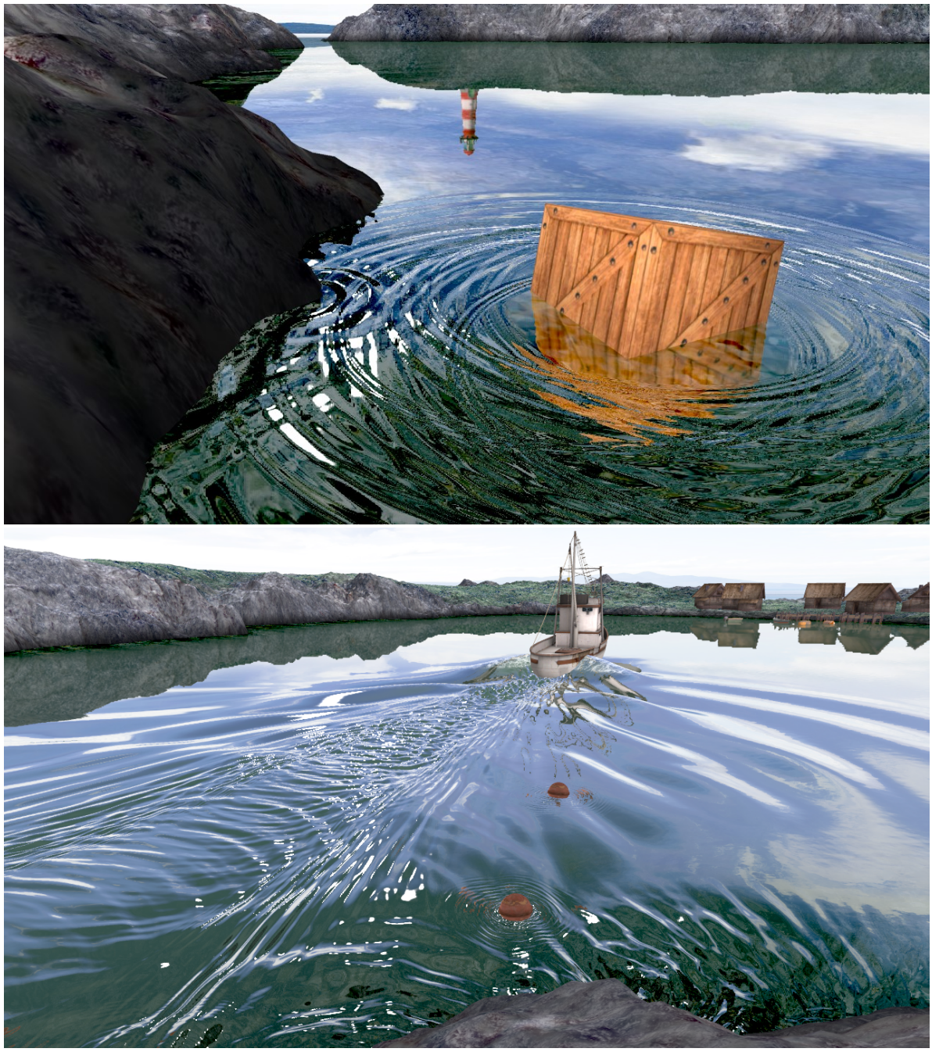
Advanced Water Wave (A)
Advanced water wave animation
Implement advanced wave particles or procedural methods to solve the wave equation
Render the water surface for example with OpenGL and texture
Real-time required
Reference
[2017] Water Wave Packets
[2018] Water Surface Wavelets

Slide 6
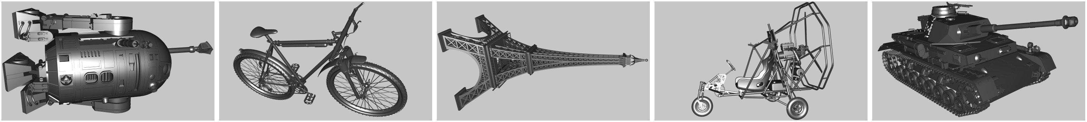
Ray Tracing NURBS Surface (B)
Rendering continues NURBS surface directly
No meshing is required for rendering
Implement ray-surface intersection algorithm
Integrate into the ray-tracing framework with global illumination
Implement a fast GPU version or something else may get A
Reference
[2000] Practical Ray Tracing of Trimmed NURBS Surfaces
[2021] Optimizing Ray Tracing of Trimmed NURBS Surfaces on the GPU

Slide 7
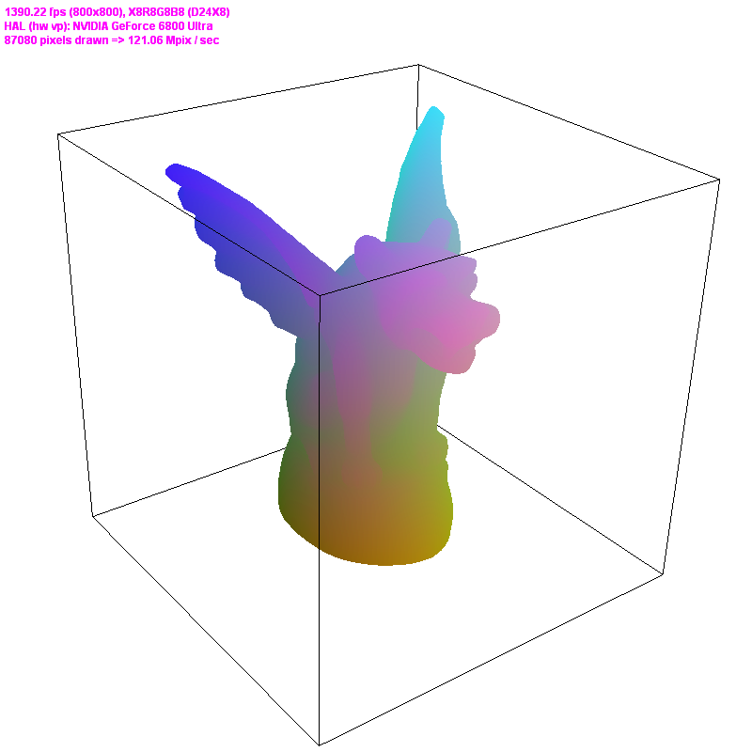
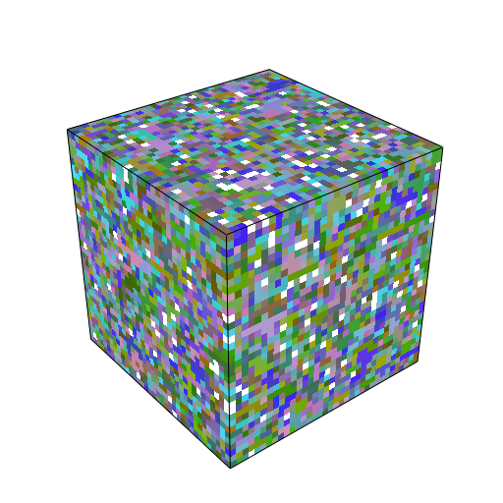
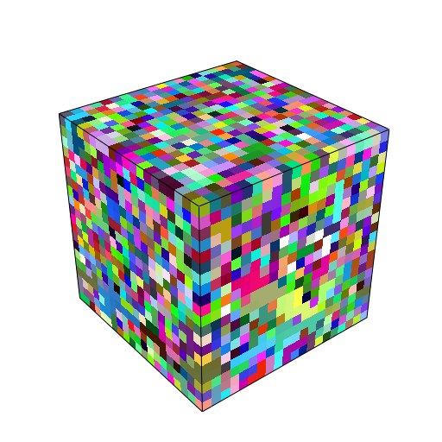
Sparse Volume Visualization (B)
Rendering a sparse volume with advanced data structure
Implement hash table, BVH, K-d Trees or other data structures or other accelerating techs.
The faster the better.
Real-time may get A
Reference
[2009] Real-Time Parallel Hashing on the GPU
[2022] Sparse Volume Rendering using Hardware Ray Tracing and Block Walking
[2011] Coherent Parallel Hashing
[2006] Perfect Spatial Hashing

Slide 8
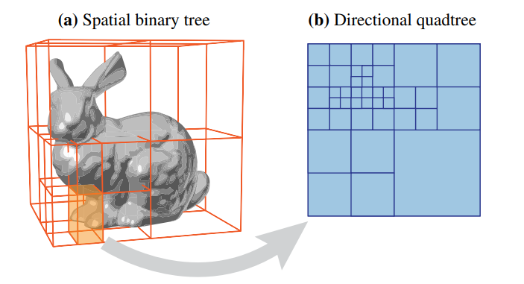
Path Guiding (B)
Rendering surface with path guiding
Path Guiding with SD-Trees
Reference
[2017]Practical Path Guiding for Efficient Light-Transport Simulation
[2020]Practical Product Path Guiding Using Linearly Transformed Cosines

Slide 9
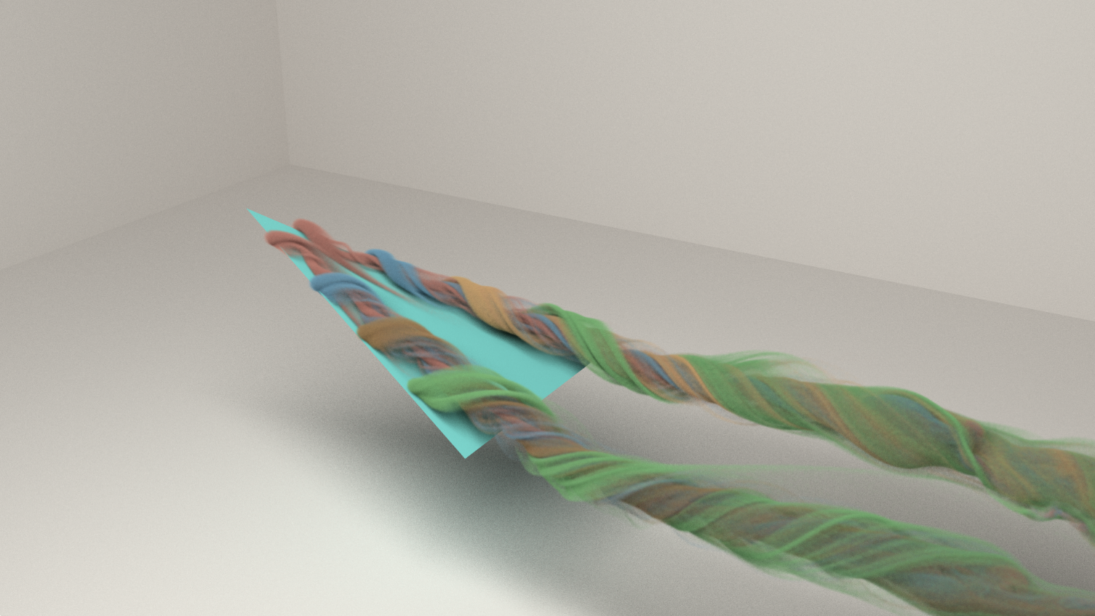
Realistic Smoke Rendering (B)
Rendering smoke by volumetric techniques
Volume data saved in VDB files
Multiple scattering
Shadow effects
Combined with surface rendering
Reference
Paper: [2017] Spectral and Decomposition Tracking for Rendering Heterogeneous
Library: OpenVDB, NanoVDB.

Slide 10
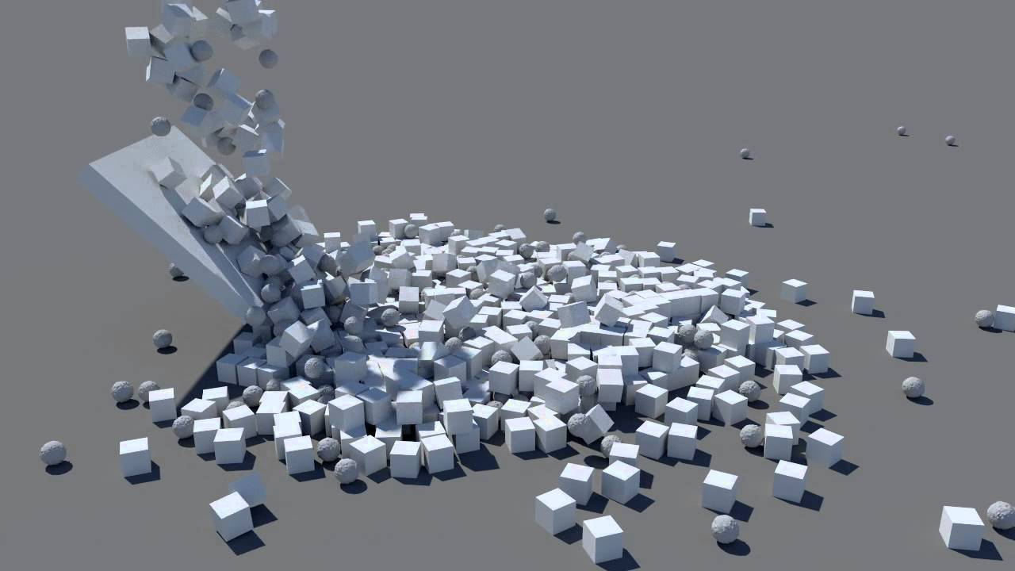
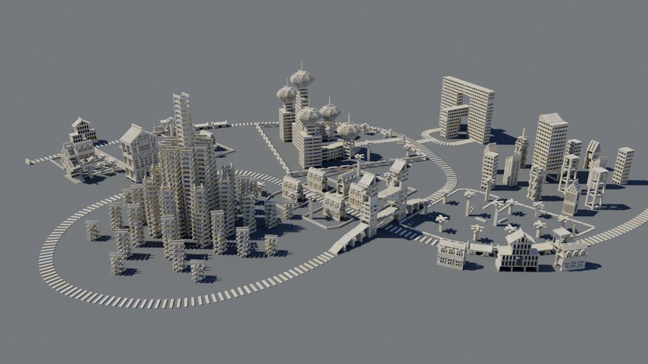
Massive Rigid-Body Simulation (B)
Implement the massive rigid body simulation
Basic transformation: translation + rotation over time
Collision detection
Handling colliding and resting contacts
Reference:
Iterative Dynamics with Temporal Coherence

Slide 11
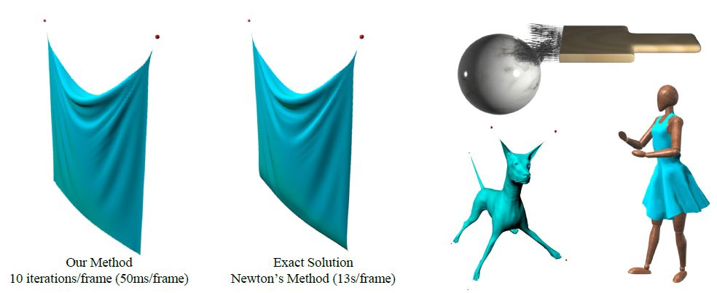
Cloth Simulation with Mass-Spring Model (B)
Fast Simulation of Mass-Spring System
Implementation of the fast non-linear cloth simulation solver
Possibly GPU parallel implementation with CUDA
Reference
Fast Simulation of Mass-Spring Systems (utah.edu)

Slide 12
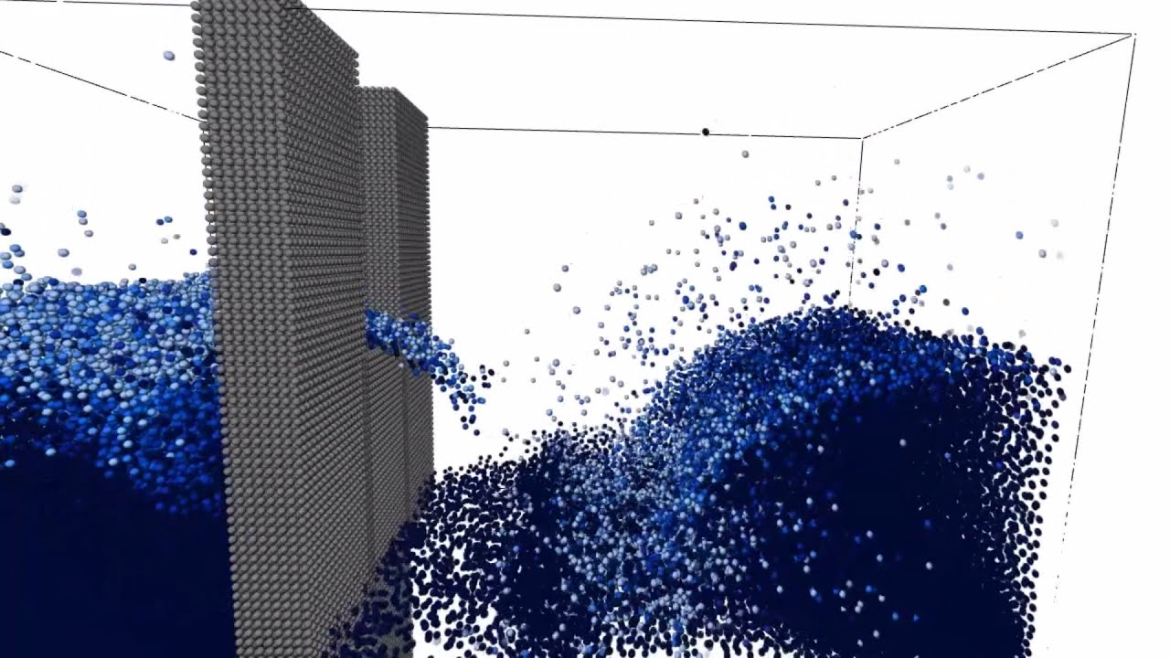
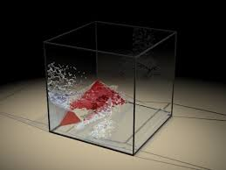
Liquid Simulation by SPH Method (B)
Implement the incompressible SPH solver for particle-based liquid simulation
The basic SPH solver (can use existing range search library)
The incompressible SPH solver
Surface extraction for rendering or render particles
Reference
https://people.inf.ethz.ch/~sobarbar/papers/Sol09/Sol09.pdf

Slide 13
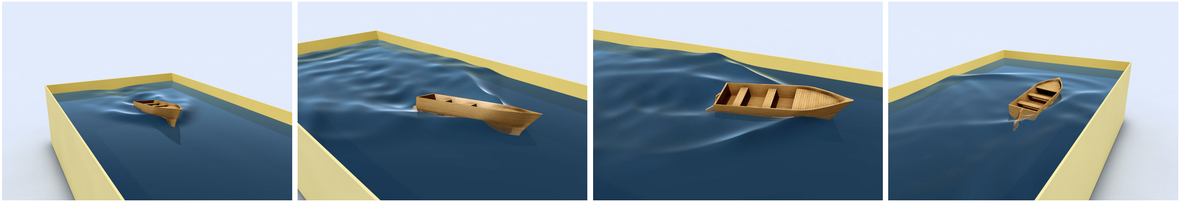
Water Wave (B)
Simple water wave animation
Implement wave particles or convolution methods to solve the wave equation
Render the water surface for example with OpenGL and texture
Reference
[2007] Wave Particles
[2016] Dispersion Kernels for Water Wave Simulation

Slide 14
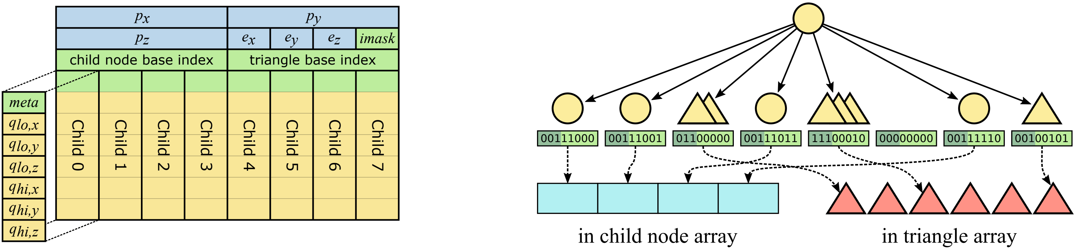
Compressed Wide BVH (B)
Compressed wide BVH
Implement parallel building algorithms for compressed wide BVH
Implement traversal algorithms for compressed wide BVH
Reference
[2017] Efficient Incoherent Ray Traversal on GPUs Through Compressed Wide BVHs

Slide 15
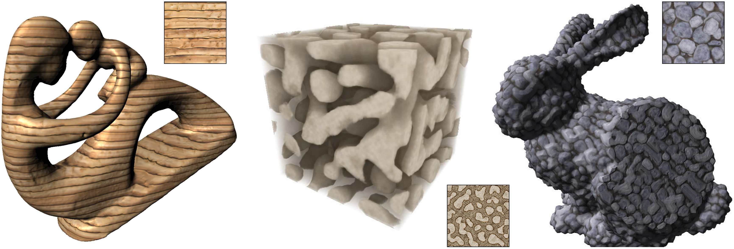
Solid Texture (B)
Solid texture synthesis
Implement one or more methods to synthesize solid textures
Visualize your solid texture
Reference
[2007] Solid Texture Synthesis from 2D Exemplars
[2008] Lazy Solid Texture Synthesis
[2008] Lapped Solid Textures: Filling a Model with Anisotropic Textures
[2010] Vector Solid Textures

Slide 16
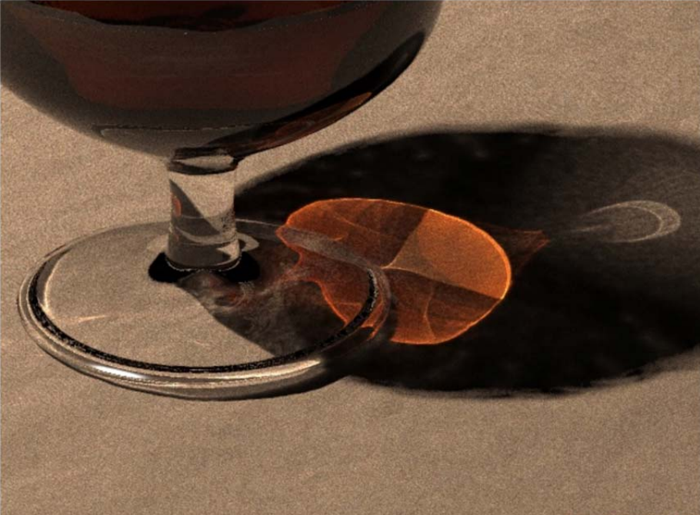
Photon Mapping (B)
Create an offline renderer using photon mapping techniques
Capable of handling caustics from light refraction through transparent substances.
Reference
[2009] Stochastic progressive photon mapping

Slide 17
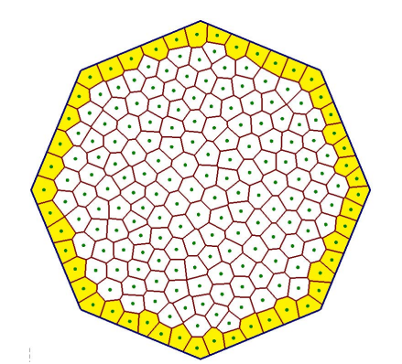
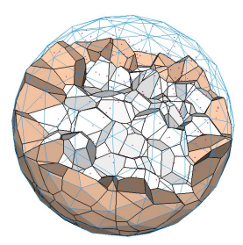
Voronoi Diagram (C)
Compute 2D/3D clipped Voronoi Diagram
Voronoi Diagram in a limited area is called clipped Voronoi Diagram.
Implement basic or advanced algorithm to construct Voronoi Diagram on 2D/3D erea.
Implement 2D will get C
Implement a fast 3D version may get B
Implement an extremely fast 3D version may get A
Reference
[1986] A sweepline algorithm for Voronoi diagrams
[2016] Efficient Computation of 3D Clipped Voronoi Diagram
[2020] Parallel computation of 3D clipped Voronoi diagrams

Slide 18
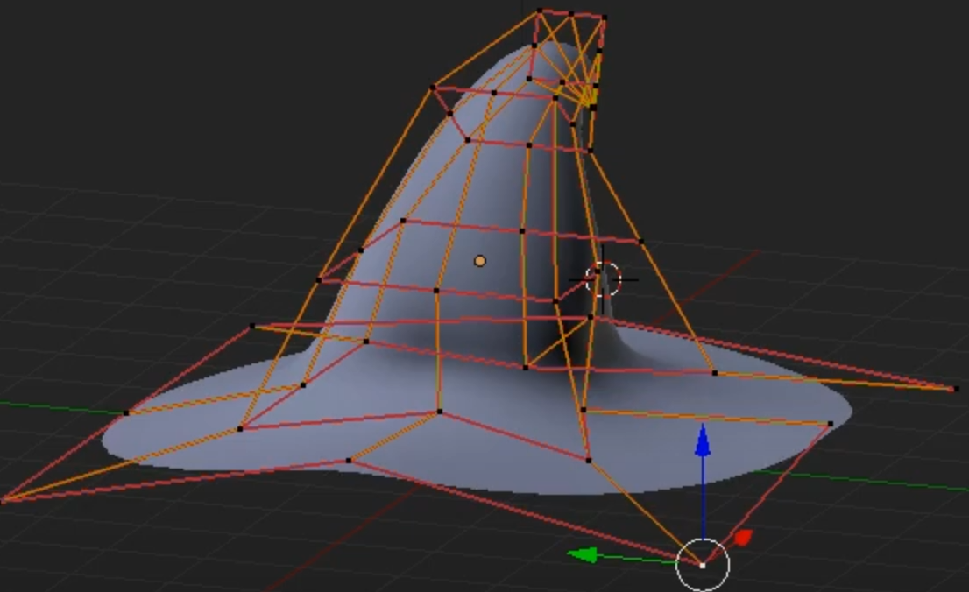
NURBS Surface Editing (C)
A small interactive NURBS modeling editor
Implement NURB evaluator
Create an interactive UI system for surface editing
Reference:
Piegl L, Tiller W. The NURBS book[M].

Slide 19
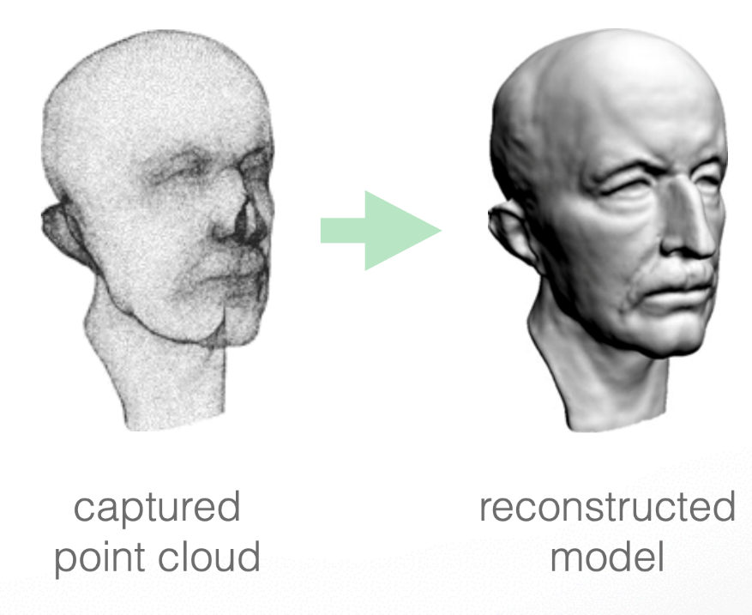
Surface Reconstruction (C)
Poisson surface reconstruct from point clouds
Estimate SDF of point clouds by Poisson equation
Extract meshes via marching cubes
Reference:
Michael Kazhdan, et al.
Poisson surface reconstruction

Slide 20
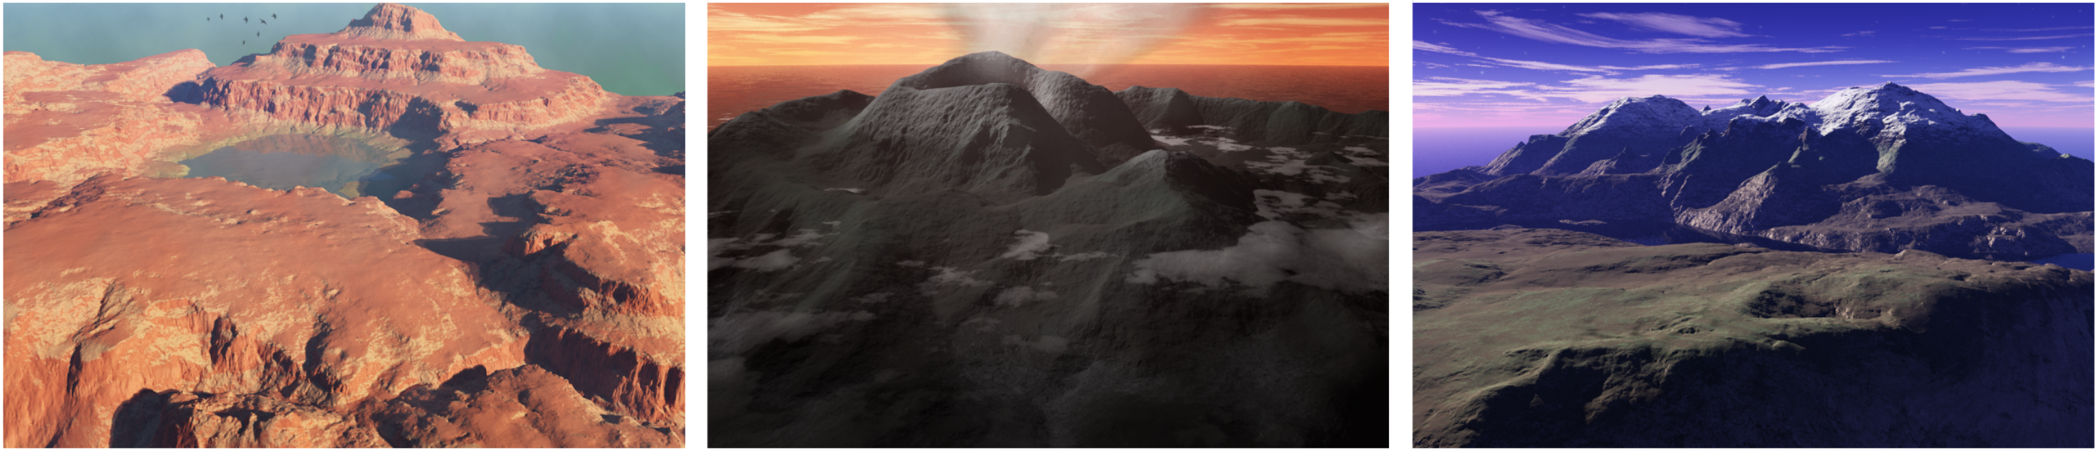
Terrain Synthesis (C)
Synthesize terrain for use in computer games
Synthesize terrain with stochastic heightmap or other methods
Free-view navigation in the generated terrain (first-person perspective).
Reference
[2004] Realtime Procedural Terrain Generation
[2007] Terrain Synthesis from Digital Elevation Models
[2015] Parallel, Realistic and Controllable Terrain Synthesis

